Slide 1
MACHINE LEARNING
Metrics – classification & regression
Confusion Matrix
Gain and Lift Chart
Kolmogorov Smirnov Chart
AUC – ROC
Gini Coefficient
Concordant – Discordant Ratio
Root Mean Squared Error
Mean Absolute Error

Slide 2
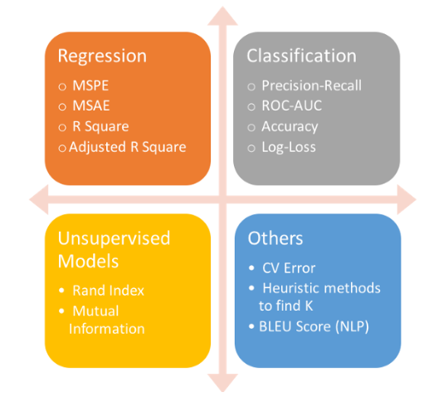
TYPES OF PREDICTIVE MODELS
Predictive models
Either a regression model (continuous output) or
A classification model (nominal or binary output).
The evaluation metrics used in each of these models
are different.

Slide 3
CONFUSION MATRIX
also known as an error matrix.
A confusion matrix is a table that is often used to describe the performance of a classification model (or “classifier”) on a set of test data for which the true values are known. It allows the visualization of the performance of an algorithm.
It allows easy identification of confusion between classes e.g. actual and predicated classes
Most performance measures are computed from the confusion matrix.
Accuracy : the proportion of the total number of predictions that were correct.
Positive Predictive Value or Precision : the proportion of positive cases that were correctly identified.
Negative Predictive Value : the proportion of negative cases that were correctly identified.
Sensitivity or Recall : the proportion of actual positive cases which are correctly identified.
Specificity : the proportion of actual negative cases which are correctly identified.

Slide 4
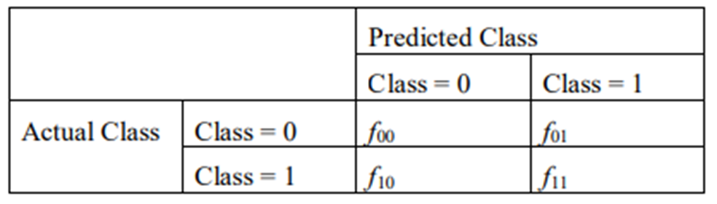
CONFUSION MATRIX
Norms on confusion matrix
0 - Negative (E.g. does not have diabetes, NO)
1 - Positive (E.g. has diabetes, or YES)
f₀₀ – True Negative (TN)
f₁₁ – True Positive (TP)
f₀₁ – False Positive (FP) .. Also called type-1
f₁₀ – False Negative (FN) .. Also called type-
correct predictions 🡪 f₀₀ + f₁₁ || Incorrect predictions 🡪 f₀₁ + f₁₀.
accuracy = correct predictions / total predictions
= (f₀₀ + f₁₁) / (f₀₀ + f₁₀ + f₀₁ + f₁₁).
error rate = incorrect predictions / total predictions
= (f₁₀ + f₀₁) / (f₀₀ + f₁₀ + f₀₁ + f₁₁).

Slide 5
QUIZ ON POSITIVES AND NEGATIVES
True (test/ reference)
1 | 0 | 0 | 0 | 0 | 1 | 1 | 1 | 0 | 0
0 | 0 | 0 | 1 | 0 | 0 | 0 | 0 | 1 | 1
0 | 1 | 0 | 1 | 0 | 0 | 1 | 1 | 1 | 1
0 | 0 | 0 | 0 | 0 | 1 | 1 | 1 | 0 | 1
Predicated

Slide 6
BINARY CLASSIFICATION (MEDICAL TESTING)
Negative – person does not have disease
Positive – person does have the disease
A false positive is an error in data reporting in which a test result improperly indicates presence of a condition, such as a disease (the result is positive), when in reality it is not present,
(type-1 error)
A false negative is an error in which a test result improperly indicates no presence of a condition when it actually is present
(type-II error)
False alarm

Slide 7
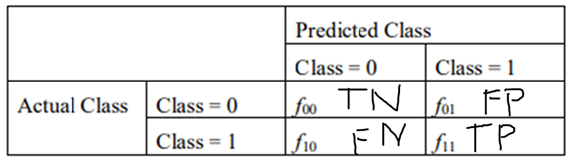
COST OF DIFFERENT TYPES OF MISTAKES
 | Email spam detection | Medical diagnosis
False Negative | Spam, but in inbox (annoying) | Has disease but predicated no disease (higher cost)
False Positive | Email lost (Higher cost) | Does not have disease but predicted to have disease (wrong treatment)

Slide 8
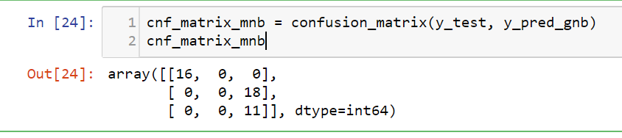
IN SKLEARN - EXAMPLE
First pass the test/reference values and then the predicated values, otherwise the confusion matrix will report correctly on errors

Slide 9
METRICS
Accuracy – overall how often is the classifier accurate?
Metric | Formula | interpretation
accuracy | correct predictions / total predictions = (f00 + f11) / (f00 + f10 + f01 + f11). = (TP + TN)/ (TP+ TN + FP + FN) | A 99% accuracy can be excellent, good, mediocre, poor or terrible depending upon the problem.

Slide 10
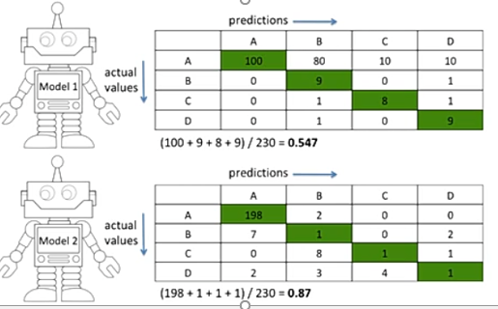
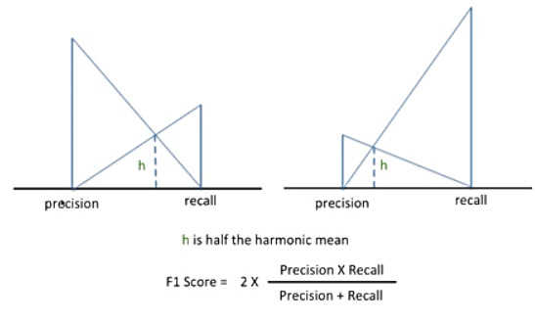
WHY ACCURACY METRIC IS NOT SUFFICIENT
Accuracy – this good in case of balanced classes where the number of samples are uniform across
F1-score – suppresses the extreme values (harmonic mean)

Slide 11


METRICS
Recall/Sensitivity/True Positive Rate/Hit Rate – when the actual value is POSITIVE (or 1), how often is the classifier predicting correctly?
Formula | interpretation
ratio of the total number of correctly classified positive examples divide to the total number of positive examples. = TP/(TP+FN) | High Recall indicates the class is correctly recognized
maximize

Slide 12


METRICS
Specificity – when the actual value is NEGATIVE (or 0), how often is the classifier predicting correctly?
Formula | interpretation
ratio of the total number of correctly classified negative examples divide to the total number of negative examples. = TN/(TN+FP) metrics.recall_score(y_test, y_pred_gnb) 🡪 for binary classification | High Specificity indicates the class is correctly recognized
maximize

Slide 13
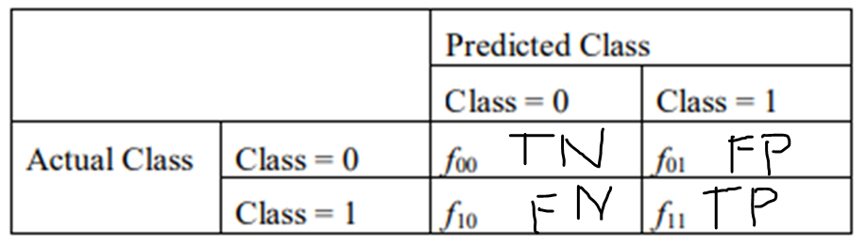
METRICS
Precision when a positive value is predicted, how often is the prediction correct?
Formula | interpretation
divide the total number of correctly classified positive examples by the total number of predicted positive examples. = TP/(TP + FP)
High recall, low precision: This means that most of the positive examples are correctly recognized (low FN) but there are a lot of false positives.
Low recall, high precision: This shows that we miss a lot of positive examples (high FN) but those we predict as positive are indeed positive (low FP)

Slide 14
METRICS
FPR – False positive rate when a negative sample is predicted as positive.
Formula | interpretation
divide the total number of correctly classified negative examples by the total number of predicted negative examples. = FP/(TN + FP) | higher FPR, the more negative data points will be misclassified.

Slide 15
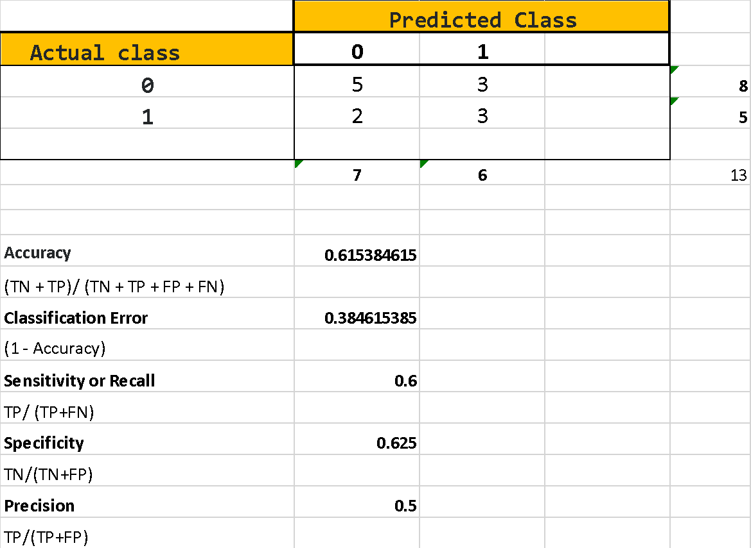
EXAMPLE

Slide 16
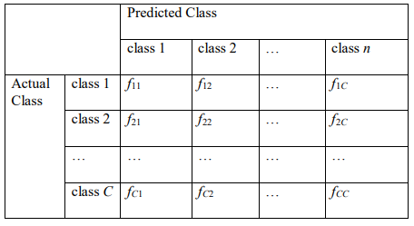

MULTI CLASS

Slide 17
CONFUSION MATRIX FOR MULTI-CLASS
Total number of test samples
= sum of corresponding row
= TP + FN
FN = row sum – TP
FP = Col sum – TP
TN = sum all – (row + col of that class)
predicted
 | A | B | C | D | E
A | TP_{A} | E_{AB} | E_{AC} | E_{AD} | E_{AE}
B | E_{BA} | TP_{B} | E_{BC} | E_{BD} | E_{BE}
C | E_{CA} | E_{CB} | TP_{C} | E_{CD} | E_{CE}
D | E_{DA} | E_{DB} | E_{DC} | TP_{D} | E_{DE}
E | E_{EA} | E_{EB} | E_{EC} | E_{ED} | TP_{E}
actual

Slide 18
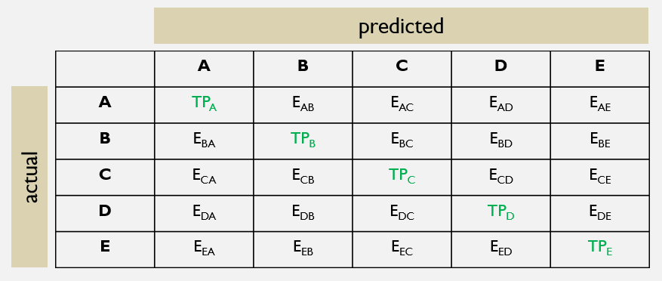
METRICS
metrics
Accuracy | (Sum of all TPs) / (sum of all classifications)
Precision A | TP/(TP + FP) = TP_{A} / (TP_{A} + E_{BA} + E_{CA}+ E_{DA} + E_{EA})
Recall A | TP/(TP+FN) = TP_{A} / (TP_{A} + E_{AB} + E_{AC}+ E_{AD} + E_{AE})

Slide 19
AUC SCORE & ROC CURVE
AUC, or Area Under Curve, is a metric for binary classification.
The second most popular one, after accuracy.
The ROC Curve is a plot of values of the False Positive Rate (FPR) versus the True Positive Rate (TPR) for a specified cutoff value.

Slide 20
RECAP ON METRICS
4 possible outcomes:
True Positives (TP) = the number of cases which were predicted to be a success/positive and were actually observed to be a success/positive
True Negatives (TN) = the number of cases which were predicted to be a failure/negative and were actually observed to be a failure/negative
False Positives (FP) = the number of cases which were predicted to be a success/positive but were actually observed to be a failure/negative
False Negatives (FN) = the number of cases which were predicted to be a failure/negative but were actually observed to be a success/positive
PP = predicted positive = TP + FP,
PN = predicted negative = FN + TN,
OP = observed positive = TP + FN,
ON = observed negative = FP + TN and
Tot = the total sample size = TP + FP + FN + TN.

Slide 21
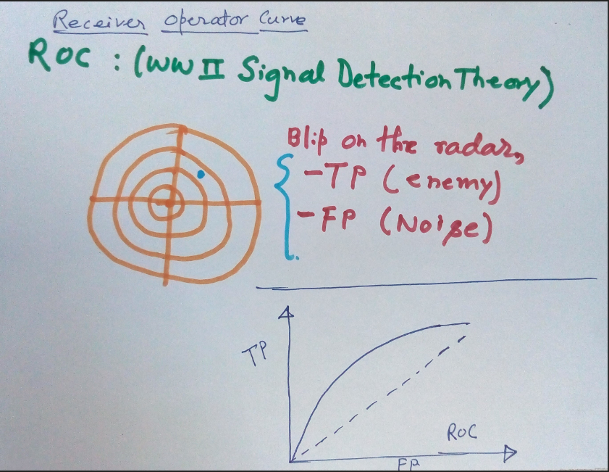
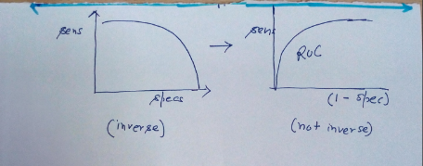
BACKGROUND

Slide 22
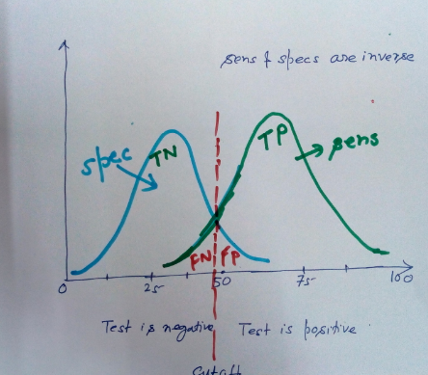
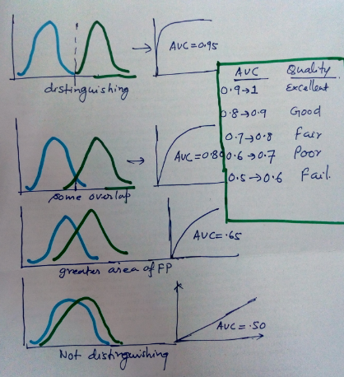
EXAMPLES – ROC CURVE

Slide 23
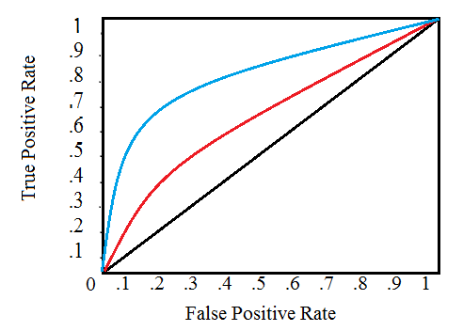
ROC CURVES
ROC – receiver Operating Characteristics
For visual comparison of models
Plot of TRUE positive rate and FALSE positive rate e.g. (1,1 and 0, 1)
The area under the ROC curve is the measure of accuracy of the model
A perfect test has an area under the ROC curve (AUROC) of 1.
A ROC curve showing two tests. The red test is closer to the diagonal and is therefore less accurate than the blue test.

Slide 24
ROC PLOT
The relationship between sensitivity and specificity.
For example, a decrease in sensitivity results in an increase in specificity.
Test accuracy; the closer the graph is to the top and left-hand borders, the more accurate the test.
Likewise, the closer the graph to the diagonal, the less accurate the test.
A perfect test would go straight from zero up the the top-left corner and then straight across the horizontal.

Slide 25

REGRESSION METRICS
RMSE (Root Mean Square Error)
It represents the sample standard deviation of the differences between predicted values and observed values (called residuals).
Mathematically, it is calculated using this formula:

Slide 26

REGRESSION METRICS
MAE
is the average of the absolute difference between the predicted values and observed value.
The MAE is a linear score which means that all the individual differences are weighted equally in the average.
For example, the difference between 10 and 0 will be twice the difference between 5 and 0. However, same is not true for RMSE.
Mathematically, it is calculated using this formula:

Slide 27
REGRESSION METRICS
RMSE vs MAE - So which one should you choose and why?
Let’s understand with the two examples:
Case 1: Actual Values = [2,4,6,8] , Predicted Values = [4,6,8,10]
Case 2: Actual Values = [2,4,6,8] , Predicted Values = [4,6,8,12]
MAE for case 1 = 2.0, RMSE for case 1 = 2.0
MAE for case 2 = 2.5, RMSE for case 2 = 2.65
RMSE penalizes the last value prediction more heavily than MAE.
Generally, RMSE will be higher than or equal to MAE.
The only case where it equals MAE is when all the differences are equal or zero (true for case 1 where the difference between actual and predicted is 2 for all observations).

Slide 28
CLUSTERING METRICS
The sklearn.metrics.cluster submodule contains evaluation metrics for cluster analysis results.
There are 2 forms of evaluation:
supervised, which uses a ground truth class values for each sample.
unsupervised, which does not and measures the ‘quality’ of the model itself.

Slide 29
CLUSTERING METRICS
metrics.adjusted_mutual_info_score (…[, …]) | Adjusted Mutual Information between two clusterings.
metrics.adjusted_rand_score(labels_true, …) | Rand index adjusted for chance.
metrics.calinski_harabaz_score(X, labels) | Compute the Calinski and Harabaz score.
metrics.davies_bouldin_score(X, labels) | Computes the Davies-Bouldin score.
metrics.completeness_score(labels_true, …) | Completeness metric of a cluster labeling given a ground truth.
metrics.cluster.contingency_matrix(…[, …]) | Build a contingency matrix describing the relationship between labels.
metrics.fowlkes_mallows_score(labels_true, …) | Measure the similarity of two clusterings of a set of points.
metrics.homogeneity_completeness_v_measure(…) | Compute the homogeneity and completeness and V-Measure scores at once.
metrics.homogeneity_score(labels_true, …) | Homogeneity metric of a cluster labeling given a ground truth.
metrics.mutual_info_score(labels_true, …) | Mutual Information between two clusterings.
metrics.normalized_mutual_info_score(…[, …]) | Normalized Mutual Information between two clusterings.
metrics.silhouette_score(X, labels[, …]) | Compute the mean Silhouette Coefficient of all samples.
metrics.silhouette_samples(X, labels[, metric]) | Compute the Silhouette Coefficient for each sample.
metrics.v_measure_score(labels_true, labels_pred) | V-measure cluster labeling given a ground truth.
https://scikit-learn.org/stable/modules/classes.html#module-sklearn.metrics

Slide 30
SKLEARN.METRICS.ADJUSTED_RAND_SCORE
The Rand Index computes a similarity measure between two clusterings by considering all pairs of samples and counting pairs that are assigned in the same or different clusters in the predicted and true clusterings.
The raw RI score is then “adjusted for chance” into the ARI score using the following scheme:
ARI = (RI - Expected_RI) / (max(RI) - Expected_RI)
The adjusted Rand index is thus ensured to have a value close to 0.0 for random labeling independently of the number of clusters and samples and exactly 1.0 when the clusterings are identical (up to a permutation).
ARI is a symmetric measure:
adjusted_rand_score(a, b) == adjusted_rand_score(b, a)

Slide 31


RI - RAND INDEX
The Rand index or Rand measure (named after William M. Rand) in statistics, and in particular in data clustering, is a measure of the similarity between two data clusterings.
is the number of unordered pairs in a set of n elements.
For example, if you have set of 4 elements {a, b, c, d}, there are 6 unordered pairs: {a, b}, {a, c}, {a, d}, {b, c}, {b, d}, and {c, d}.
The a in the formula refers to the number of times a pair of elements belongs to a same cluster across two different clustering results
the b refers to the number of times a pair of elements are in different clusters across two different clustering results.

Slide 32
RI - RAND INDEX
Say we have a set of six elements: {a, b, c, d, e, f}
Clustering method 1 (CM1) forms 3 clusters;
the first 2 items are in group 1
the 3rd and 4th are in group 2
the 5th and 6th are in group 3
{1, 1, 2, 2, 3, 3}.
Clustering method 2 (CM2) forms 2 clusters;
the first three items are in group 1
the last three items are in group 2
{1, 1, 1, 2, 2, 2}
What’s the Rand index of these two clustering results?

Slide 33

RI - RAND INDEX
To manually calculate the Rand index, we need to go through every unordered pair to work out a and b ;
let’s work out a first.
There are 15 unordered pairs in a set of six elements: {a, b}, {a, c}, {a, d}, {a, e}, {a, f}, {b, c}, {b, d}, {b, e}, {b, f}, {c, d}, {c, e}, {c, f}, {d, e}, {d, f}, and {e, f}.
a is every time a pair of elements is grouped together by the two clustering methods.
{a, b} and {e, f} are clustered together by CM1 and CM2, so a = 2
b is every time a pair of elements is not grouped together by the two clustering methods. {a, d}, {a, e}, {a, f}, {b, d}, {b, e}, {b, f}, {c, e}, and {c, f} are not clustered together by CM1 and CM2, so b = 8.

Slide 34
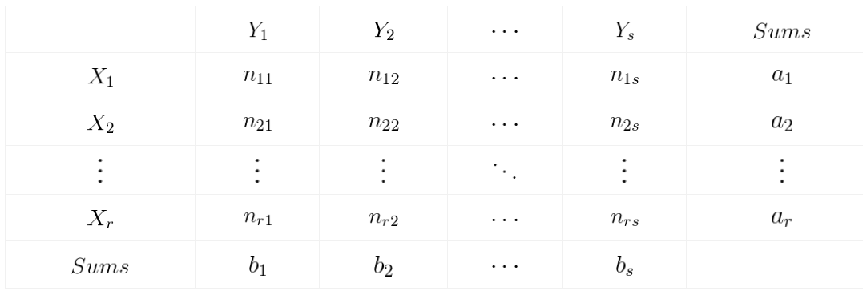
ADJUSTED RAND INDEX
corrected-for-chance version of the Rand index

Slide 35
SKLEARN.METRICS.HOMOGENEITY_SCORE
Homogeneity metric of a cluster labeling given a ground truth.
A clustering result satisfies homogeneity if all of its clusters contain only data points which are members of a single class.
This metric is independent of the absolute values of the labels: a permutation of the class or cluster label values won’t change the score value in any way.
This metric is not symmetric: switching label_true with label_pred will return the completeness_score which will be different in general.

Slide 36

SKLEARN.METRICS.SILHOUETTE_SCORE
If the ground truth labels are not known, evaluation must be performed using the model itself.
a higher Silhouette Coefficient score relates to a model with better defined clusters.
The Silhouette Coefficient is defined for each sample and is composed of two scores:
a: The mean distance between a sample and all other points in the same class.
b: The mean distance between a sample and all other points in the next nearest cluster.
The Silhouette Coefficient s for a single sample is then given as:
Advantages
The score is bounded between -1 for incorrect clustering and
+1 for highly dense clustering.
Scores around 0 indicate overlapping clusters.
The score is higher when clusters are dense and well separated, which relates to a standard concept of a cluster.

